Slide 1
PLANS & IDEAS TO BE IMPLEMENTED

Slide 2
Personalized Wellness Plans :
Develop an AI-driven system that analyzes survey responses to create personalized mental health and wellness plans for tech professionals. These plans could include targeted resources, activities, and reminders based on individual needs.
Virtual Mental Health Check-ins :
Implement a regular virtual mental health check-in system using chatbots or automated messaging. This provides tech workers with a non-intrusive way to express their well-being and receive timely support or resources.

Slide 3
Peer Support Matching :
Create a platform that matches tech professionals with similar mental health challenges for peer support. This system could leverage survey data to identify common issues and facilitate connections between individuals who can offer understanding and encouragement.
Mindfulness and Stress Reduction App :
Design a mobile app that incorporates gamified elements to teach mindfulness and stress reduction techniques. The app could utilize survey responses to customize content and activities tailored to the specific stressors faced by tech workers.

Slide 4
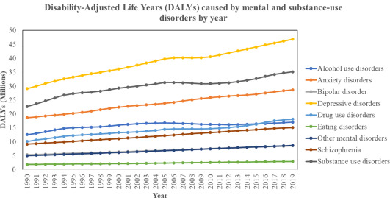

Slide 5
Real-time Stress Detection :
Integrate wearable technology or software that monitors physiological and behavioral indicators of stress in real-time. Use survey data to calibrate the system and provide timely interventions, such as prompts for short breaks or relaxation exercises.
Tech-Free Time Challenges :
Develop a platform that encourages tech professionals to take designated breaks from screens and work-related tasks. Tailor challenges and rewards based on survey insights into individual preferences and habits.

Slide 6
Mental Health Workshops :
Organize virtual workshops or webinars based on the survey results, addressing prevalent mental health concerns in the tech industry. Invite experts to provide insights, coping strategies, and practical tips.
Gaming for Mental Wellness :
Develop a series of video games specifically designed to promote mental wellness. Use survey data to identify common stressors and preferences, tailoring the gaming experience to address these issues while fostering a sense of achievement.

Slide 7
Mindful Coding Challenges :
Integrate mindfulness into coding challenges or hackathons. Use survey insights to design coding scenarios that encourage focus, creativity, and collaboration, while also incorporating mindfulness practices.
USER’S PRIVACY AND DATA SECURITY MUST BE PRIORITIZED WHLE IMPLEMENTING THESE ABOVE IDEAS

